Slide 1
UM System (and UMKC) Open & Affordable Resources Initiative
Scott Curtis, UMKC Libraries. Licensed under the Creative Commons Attribution 4.0 International License.

Slide 2
UM System Affordable & Open Educational Resources Initiative
Mission Statement
The UM System Affordable & Open Educational Resources (A&OER) initiative works to enhance the use of affordable and open educational resources at the university. A&OER provide students immediate and unlimited access to course materials, enhance learning by providing up-to-date and interactive resources, and lead to greater retention and graduation. Additionally, they help to lower the cost of education.

Slide 3
UMKC Affordable & Open Educational Resources Committee
Mission Statement
The UMKC Affordable & Open Educational Resources (A&OER) Committee works to enhance student academic success through advocating and supporting faculty use of affordable, accessible and open educational resources at the university. Through building university awareness and increasing faculty engagement, the committee strives to provide comprehensive faculty support for the creation and use of A&OER content.

Slide 4
UMKC’s A&OER Committee
Scott Curtis, Librarian (Chair)
UMKC Libraries
Bonnie Postlethwaite, Dean of Libraries UMKC Libraries
Paul Callister, Director, Law Library and
Professor UMKC School of Law
Pete Eisentrager, Assistant Director UMKC Bookstore
Amanda Grimes, Assistant Professor
School of Nursing and Health Studies
Julie Hartwell, Instructional Design Librarian
UMKC Libraries
Loretta Klamm, Lecturer School of Biological Sciences
Scott Laurent, Director Student Disability Services
Candace Schlein, Associate Professor School of Education / FaCET
Nancy Weatherholt, Associate Professor Bloch School of Management
Torie Wynn, Instructional Designer UMKC Online

Slide 5
Multiple strategies within the A&OER Initiative
While administratively the UM System Initiative is focused on a student-centric goal of lowering the cost of course materials for students, the campus A&OER Committees recognize that faculty have the opportunity and academic freedom to choose among many strategies and methods to achieve this cost reduction, including (but not limited to):
AutoAccess and publisher partnerships through UMKC Bookstore
Linking to UMKC Library-provided resources as course materials
Adopting an existing OER textbook through OpenStax, Open Textbook Network, etc.
Adopting, adapting, or creating other kinds of OER resources that aren’t textbooks for a class but that students had to purchase (e.g. lab notebooks, workbooks, etc.)

Slide 6
Our approach mirrors that of others...
“OhioLINK is passionately pursuing a multi-pronged, hybrid approach to textbook affordability. Not just OER (Open Educational Resources), not just library materials, and not just inclusive access [equivalent of UMKC’s AutoAccess]. Why? Because our sole interest in these efforts is the benefit of students, which requires us to evaluate strategies based on their potential for impact—both immediately and in the future.”
-Gwen Evans, Executive Director of OhioLINK.
See “Affordable Learning Requires a Diverse Approach, Part 1: Playing the Short Game (and the Long One) to Secure Savings for Students,” in The Scholarly Kitchen, posted October 30, 2018.

Slide 7
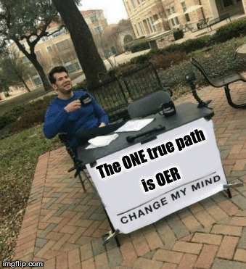
In other words,
this isn’t what we’re about...

Slide 8
Specific Activities of UMKC A&OER Committee
Support UM System Grants - Publicize application dates and deadlines, review grants, support faculty awardees.
Engage faculty with OER - Present Open Textbook Library workshops for faculty to review an OER textbook and receive a Textbook Review stipend for doing so. Foster networking events and other faculty-to-faculty conversations about experiences with AutoAccess and OER.
Build awareness among faculty, students and campus community - Presentations by UMKC Bookstore and UMKC Libraries to campus stakeholders about AutoAccess and OER. Articles written in UMatters and UMKC Online Newsletter, as well as through student publications like UNews. Collaboration and involvement with SGA and ASUM.
Gather data and report progress - Through UMKC Bookstore, measure student savings through both AutoAccess and OER use and adoption. Data are reported through UM System as well as institutional partnerships like OpenStax and SPARC.
Facilitate access and storage of faculty-created OER - Work with faculty to place faculty-created OER where they can be shared with the Open Education community.

Slide 9
OK, so what are OER?
“OER are teaching, learning, and research resources that reside in the public domain or have been released under an intellectual property license that permits their free use and re-purposing by others. Open educational resources include full courses, course materials, modules, textbooks, streaming videos, tests, software, and any other tools, materials, or techniques used to support access to knowledge.”
-The William and Flora Hewlett Foundation

Slide 10
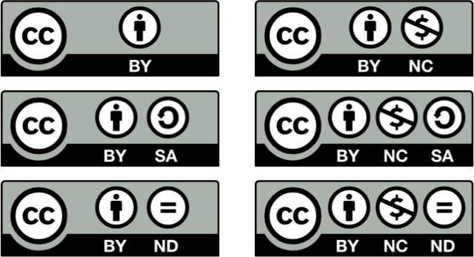
OER usually recognizable by Creative Commons licensing

Slide 11
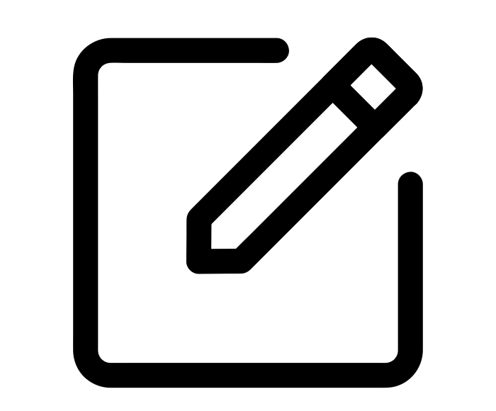
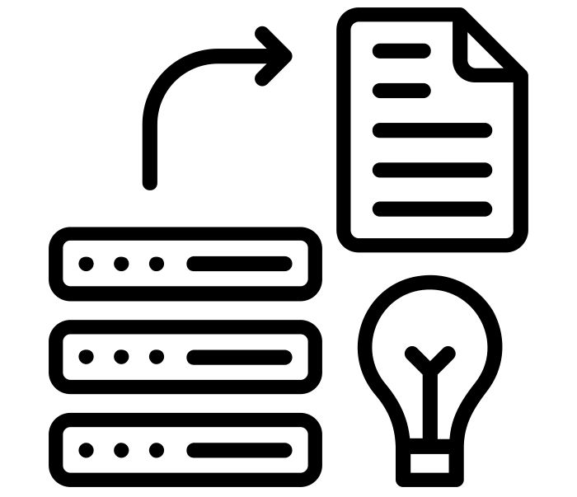
A faculty benefit of OER - more academic freedom
Copy
Share
Edit
Mix
Keep
Use
Graphic Concept CC-BY Madi Smith

Slide 12
OER Myths like these are not strictly true
Open simply means free
All OER are digital
“You get what you pay for” in quality
Copyright for OER is complicated
OER are not sustainable
Open textbooks lack ancillaries
UMKC is not ready to use OER
See “OER Mythbusting” by SPARC at https://sparcopen.org/our-work/oer-mythbusting/

Slide 13
I welcome your questions!
My presentation is time-limited. There are many aspects of this topic that could not be covered.
If you have detailed questions about specific issues, please e-mail them to me at curtissa@umkc.edu
I will make a document that contains all the questions I receive, along with detailed answers. Where appropriate, I will include or point to source material for further reading and consideration.
I will provide this document to the Faculty Senate for inclusion in the record.

Slide 14
References
About the Licenses. Creative Commons Website. https://creativecommons.org/licenses/
Evans, Gwen (2018). Affordable Learning Requires a Diverse Approach, Part 1: Playing the Short Game (and the Long One) to Secure Savings for Students. In The Scholarly Kitchen. October 30, 2018. Viewed November 1, 2018 at https://scholarlykitchen.sspnet.org/2018/10/30/affordable-learning-requires-a-diverse-approach-part-1-playing-the-short-game-and-the-long-one-to-secure-savings-for-students/
OER Mythbusting. Published by SPARC October 25, 2017. Accessible through Website. https://sparcopen.org/our-work/oer-mythbusting/
Open Educational Resources Research Guide. UMKC Libraries. Website. https://libguides.library.umkc.edu/OER
UM System Affordable & Open Educational Resources Initiative. Website. https://www.umsystem.edu/ums/aa/oer

